Slide 1
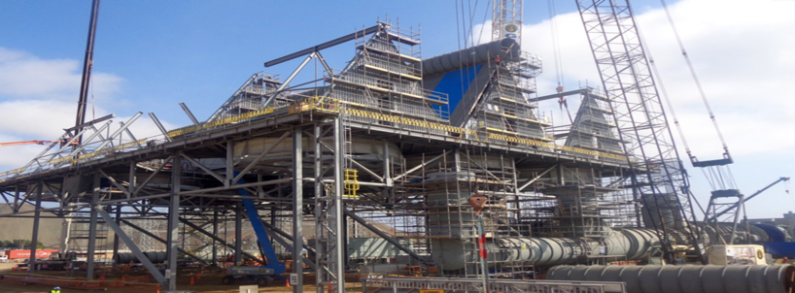
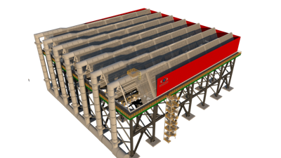
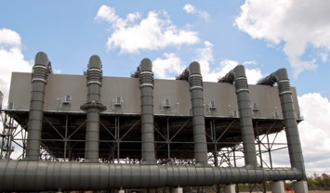
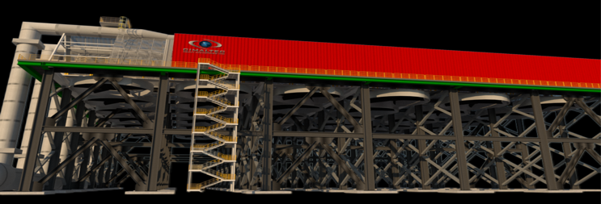
ACC AIR COOLED CONDENSERS
APPLICATIONS FOR DRY COOLING

Slide 2
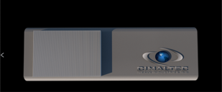
CIMALTEC®
CONTENTS
2
Our Air cooled Condenser ACC Division leaded by BEM, is backed by our experience. Over 60 years in Heat transfer and metal fabrication focused on the power industry. The Division specializes in Dry Air cooled Condensers and Surface Condensers as the design and supply of ACCs and ACHEs for the power industry. CIMALTEC has thousand of MW of operating references and experience and is considered a reliable supplier of ACC and WCC for the Mexican power sector.
CIMALTEC
3
APPLICATIONS
ABOUT CIMALTEC:
The CIMALTEC facilities are located in Mexico City, where it was born in 1958 dedicated to the production parts for light trains, later in the 80's it opens a division for the manufacture of boilers, preheaters and industrial heaters for the oil, Gas, and Energy Power Sector also in Mexico City. Early 90's the on site Works Division was born, for the develop of turnkey projects in power plants and oil refining facilities, at the end of the 90's it installed a manufacturing plant in the city of Querétaro Mexico, in order to manufacture and feed our space needs and the grow of metal and mechanical manufacturing products in the country, in mid-2005 it opened its manufacturing workshop in British Columbia, Canada, to serve the North American market and export of complex engineering products, such as surface condensers and Steam turbine cooling condenser applications. 10 years later and taking advantage of the infrastructure developed over the years, the manufacture of metal structures for heavy industry and Air cooled condensers of height greater than 20 meters begins, now managed by BEM division.
4
COOL-IN-G
MODULATION
5
ACTION
6
10
REFERENCES
Q.C.
2
www.cimaltec.ca

Slide 3
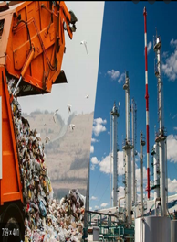
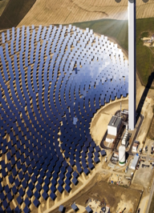
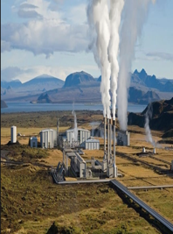
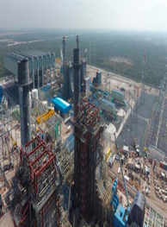
APPLICATIONS
INDUSTRY
The direct dry cooling option, condenses turbine exhaust steam inside finned tubes, which are externally cooled by ambient air instead of sea or river water, as in once-through water-cooled plants. There are two options for circulating the ambient air for condensate cooling either use fans to move the air or leverage nature’s draft.
BIOMASS (WASTE –POWER)
SOLAR TOWER
GEOTHERMAL
OIL AND GAS
COAL-OIL
C. CYCLE
www.cimaltec.ca
3

Slide 4
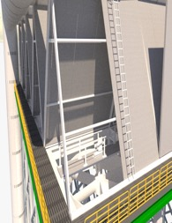
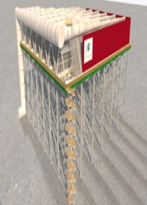
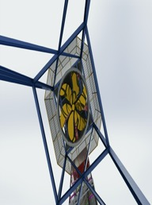
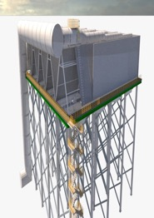
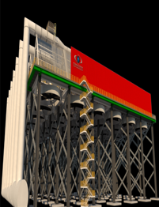
MODELING
All components are modeling to ensure the perfect performance, including: ACC Tube Bundle, Condensate tank, Steam Ejectors, Automation Equipment, Basic and detailed design, based on design system, ACC peripherals own production.
NON-CONDENSABLE (BACKUP CONDENSATE)
DISTRIBUTION
AIR FANS
HEIGH
ALL COMPONENTS
ALL IN ONE
www.cimaltec.ca
3

Slide 5
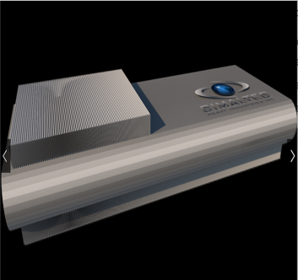
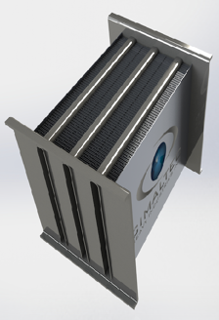
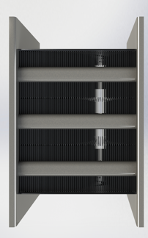
COOL-IN-G
Design
The principle difference between ACC designs from different suppliers is in the details of the heat exchanger and its finned tubes. There are basically two types of heat exchangers: single-row and multi-row. The single-row design is inherently more suitable in extreme freezing ambient conditions There are also three tube shapes available in the market: round, oval, and flat. Our flat tubes are the most sophisticated and perform better under just about all conditions.
Our Flat G Brazing Finning Tube Type
 Dependable
 Made in Steel Flat shape tube with aluminium coated for a bigger steam flow volume
 Brazed fins made with a higer aluminium alloy with our G design of single row type
 Better steam distribution
 Operation under control
 Better control under low range and pressure drop.
Suitable for:
 Combine Cycle Power plants Air Cooled Condensers
 Coal and Gas power Plants
KEY PROYECT INCLUDES
ITEM | INCLUDING
STRUCTURAL DESIGN | YES
MECHANICAL DESIGN | YES
THERMAL DESIGN | YES
CAD CAM | YES
FABRICATION | YES
SHIPMENT | YES
SPECIAL COAT | YES
INSTALLATION | YES
ENGINEER STAMP | YES
LIFT SERCIVES | YES
ALL AMERICA | YES
4
www.cimaltec.ca

Slide 6
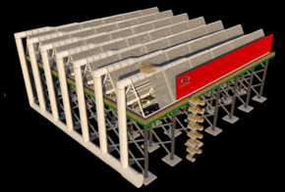
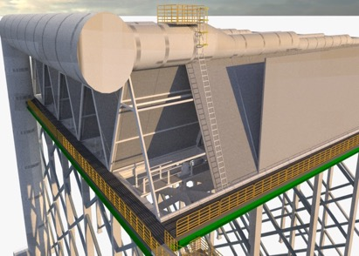
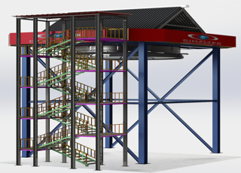
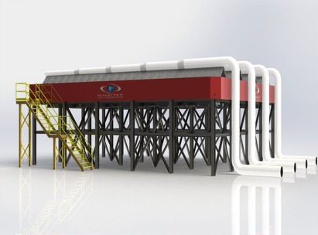
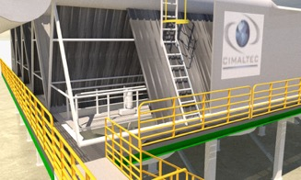
A – FRAME ACC
PROCESS:
11. DESIGN
ACERO
33. MANUFACTURING
4. INSTALLING
2. EPC MAT SUPPLY
2
www.cimaltec.ca
5

Slide 7
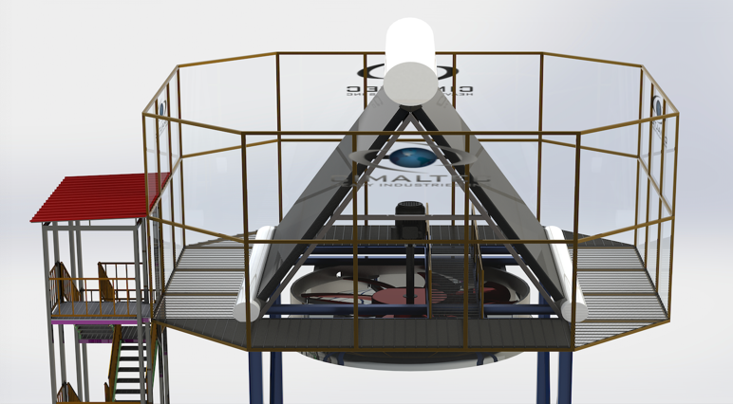
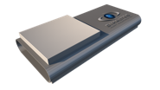
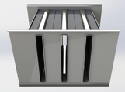
MODULATED
CELLS
Simple + Strong = Reliable
Modular Cells
Our Module cells are manufactured in the way of cells to make easier their maintenance, transfer, manufacture and installation, thereby obtaining greater efficiency and improvement in production and maintenance costs. Modulated cell design for higher efficiency for Aero condensers greater than 300 MW total production and up to 1200MW are calculated for easy handling of 15MW for steam condensate. (This may vary depending on the temperature of the place, height and other variables). Allowing a simple, strong and very reliable dynamic project in addition to better control of the operation and future savings for future growth of MW.
The single row design coupled with our G brazing fin system achieves the performance required for most environmental conditions from -10oC to 50oC . Each cell is prepared to function autonomously, which allows us to continue with the operation of the equipment in the event of failure or maintenance of the fan drive systems. We can also integrate into our models the pressure water jet cleaning systems in a modulated or combined way, automatically and programmed, guaranteeing an optimal cleaning factor for thermal transfer.
6
www.cimaltec.ca

Slide 8
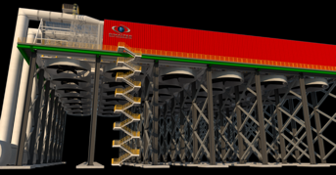
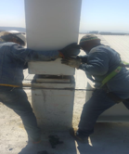
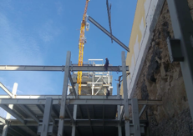
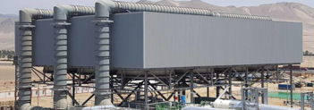
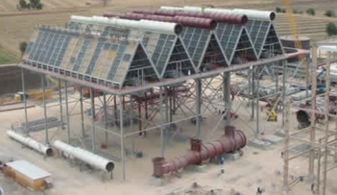
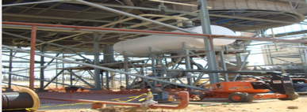
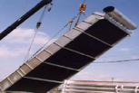
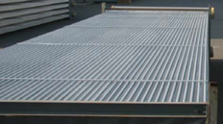
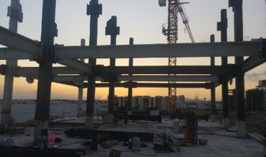
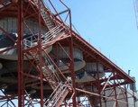
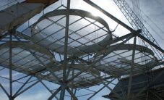
GALLERY
PROJECTS
POWER GENERATION
S
OIL AND GAS
COMBINE CYCLE POWER
www.cimaltec.ca
7

Slide 9
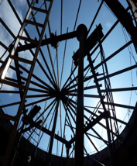
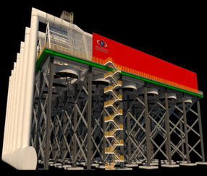
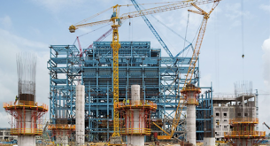
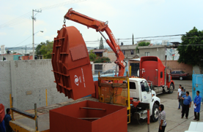
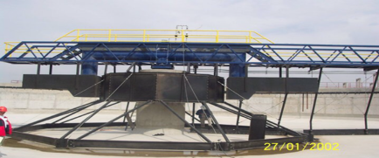
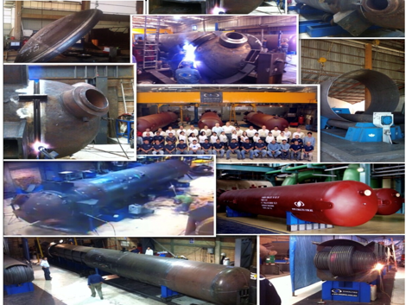
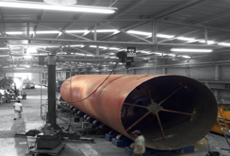
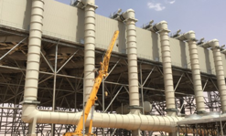
GALLERY
PROJECTS
POWER GENERATION
CHEMICAL
8
www.cimaltec.ca

Slide 10
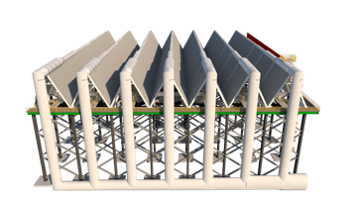
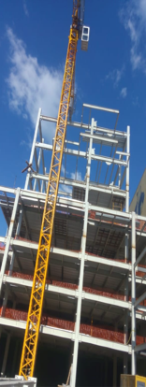
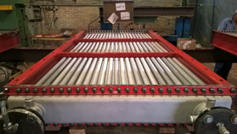
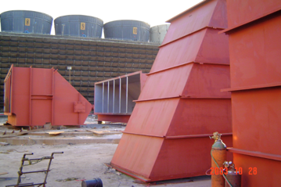
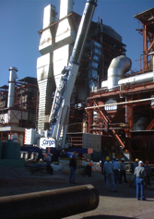
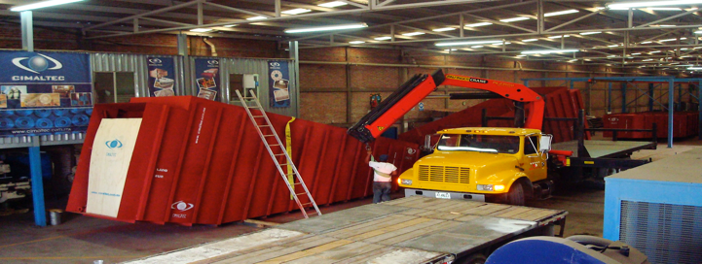
GALLERY
PROJECTS
60 YEARS OF EXPERIENCE
9
www.cimaltec.ca

Slide 11
Q.C.
ASME, API, AWS, CWB, NATIONAL BOARD.
Whatever your country is, our quality system meets and adapts to most general world quality requirements, from an AWS welder qualification to ASME pressure vessel design. If your Project is a multinational one, we will have no problem to meet the regulations of your country, such as working conditions, Health and environmental protection. And if it is for export most of the international certifications that are valid in North America and Europe, for more information on the regulations in force in your country, please write to us to arrange a conference.
10
www.cimaltec.ca

Slide 12
REFERENCES
11
www.cimaltec.ca

Slide 13
NOTES
www.cimaltec.ca
12

Slide 14
Info:
INQUIRIES
ESPUELA DEL FFCC 205
QUERETARO MEXICO 76138.
PHONE: (442) 124 8815
FAX: (442) 124 8815
E-MAIL: arturocarrillo@cimaltec.ca
www.cimaltec.ca
The information contained in this presentation is limited information, if you need additional or specific information or personalized for reference reasons, please request it with the agent who shared this with you. We remind you that every information and or quotation we make is in writing way and the prices or offers shown in this document are only valid during a limited period of time. Cimaltec es una marca registrada © 2019. Derechos Reservados.

